Slide 1

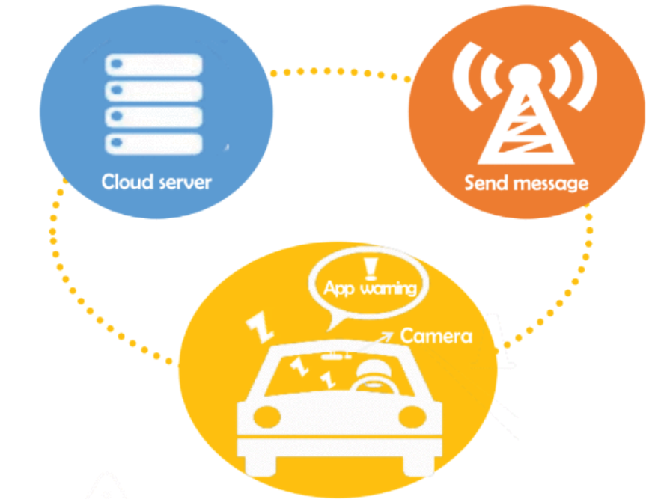
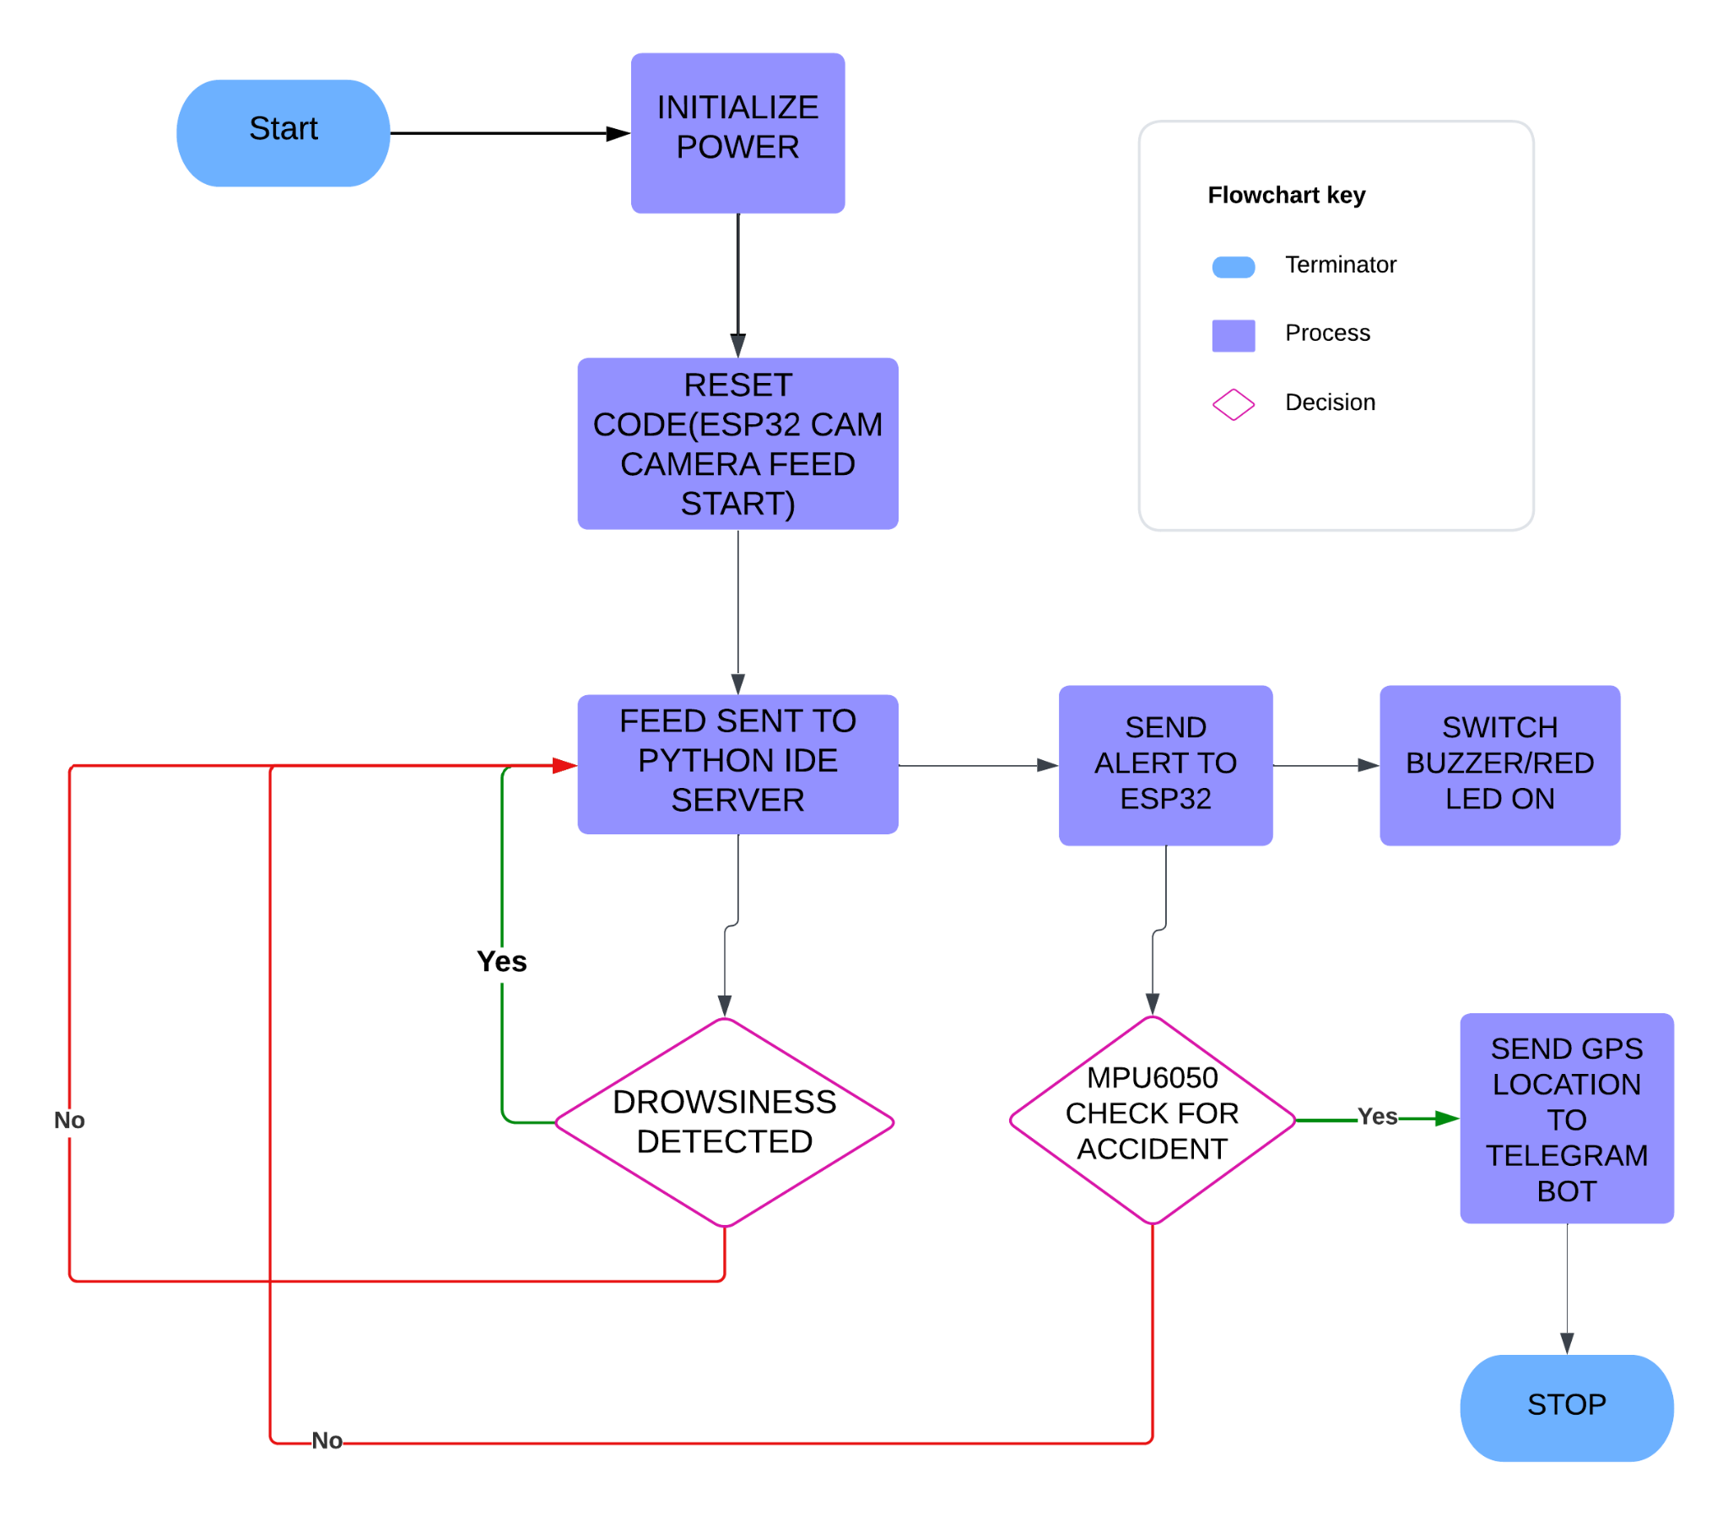
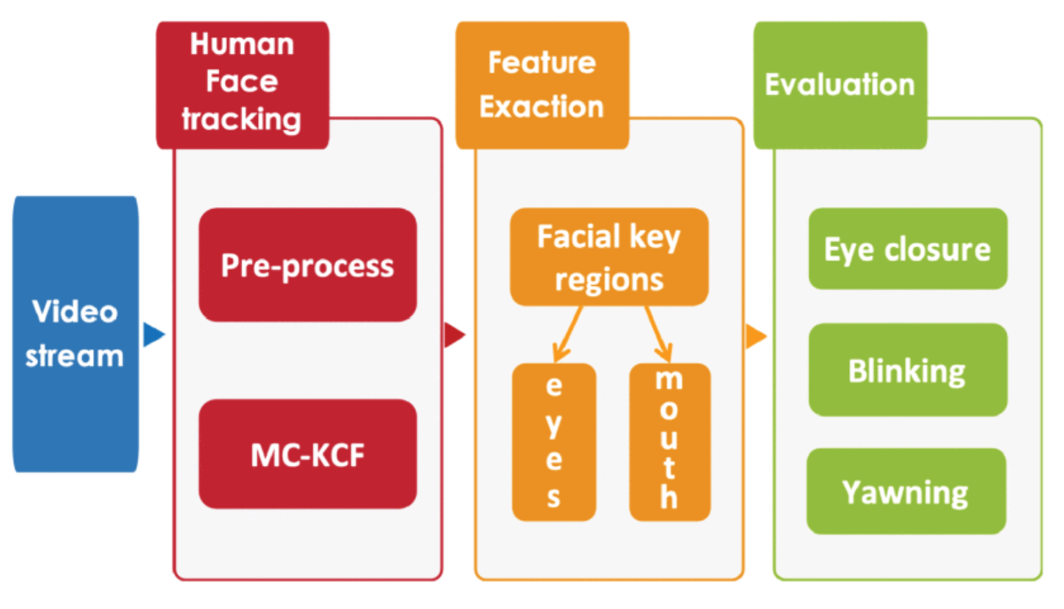
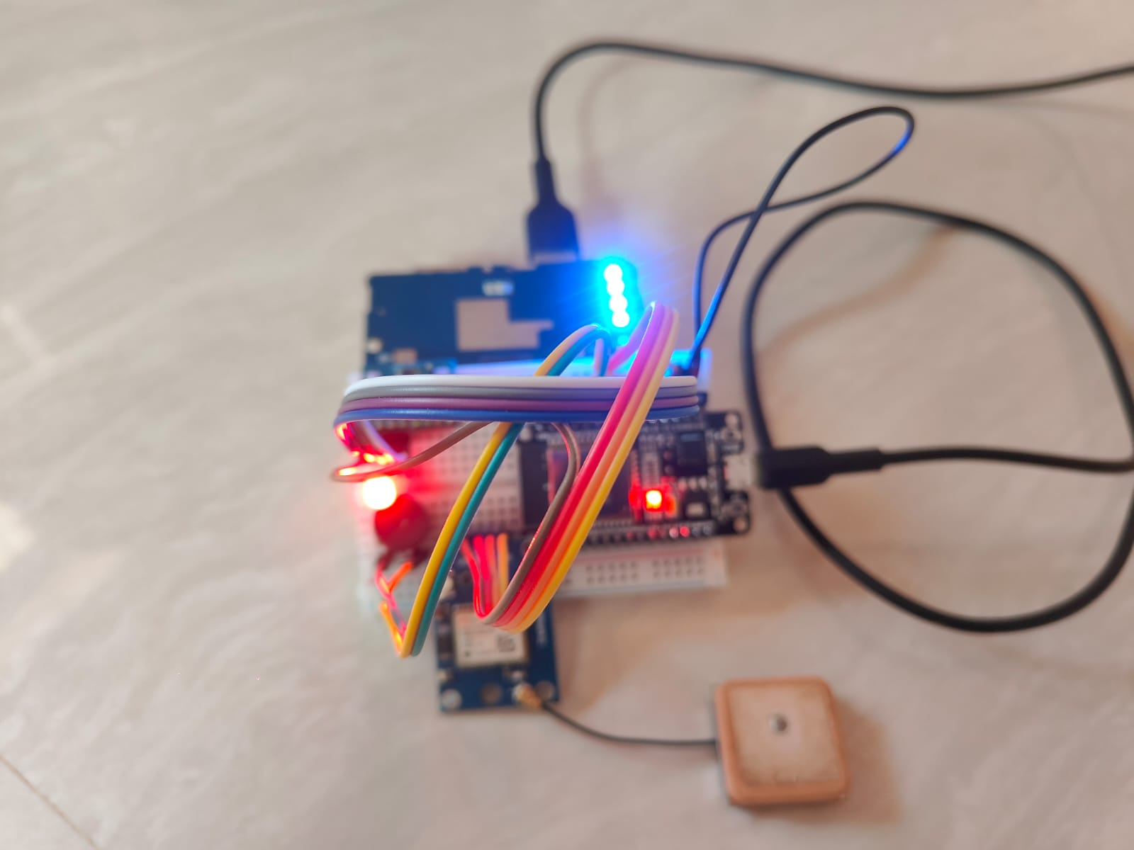
IoT Based Smart Drowsiness Detection And Notification System
Presented by: Tanmay Singh, Anikait Barik, Himanshi Deep, Manu Siddharth Verma Electronics & Computer Science Engineering
Guided by: Subhrakanta Behera
School of Electronics Engineering
Kalinga Institute of Industrial Technology (Deemed to be University), Bhubaneswar
GROUP NO. ECSc-44
Introduction
Drowsy driving is a major cause of accidents, making early detection of driver fatigue essential. This project uses IoT, sensors, and machine learning to monitor drivers and provide real-time alerts. The system improves road safety and offers a scalable solution for both personal and commercial vehicles. It detects key signs of drowsiness, such as eye closure and head nodding, providing immediate alerts to prevent accidents. It aims to reduce the risk of fatigue-related accidents, The integration of machine learning allows for continuous improvement and adaptation to individual driver patterns.
Objectives
 | Detect drowsiness through eye closure and head movement analysis. Integrate sensors and cameras for continuous driver monitoring. Utilize IoT for real-time data transmission and alerts.
Societal Impact
Reducing fatigue-related accidents can significantly lower injury and fatality rates, creating safer roads for all.
Drives innovation in the use of IoT, machine learning, and smart technologies for public safety.
Methodology
Experimental/Simulation Outcome
Fig: Flow Diagram
Fig: Prototype
Drowsiness is detected using cameras and infrared sensors that monitor eye closure and head movements. Machine learning algorithms, particularly Convolutional Neural Networks (CNNs), analyze real-time video feeds to identify patterns of fatigue.
Upon detecting drowsiness, the system triggers immediate alerts through visual notifications on the dashboard, audible alarms or on mobile apps. These alerts prompt drivers to regain awareness and can also notify fleet managers for proactive safety measures.
The experimental outcomes demonstrated that the drowsiness detection system achieved over 90% accuracy in identifying signs of fatigue, responded within five seconds of detection to issue alerts, received positive user feedback for its intuitive interface, provided valuable insights into common drowsiness triggers for algorithm refinement, performed reliably in diverse driving scenarios, and highlighted opportunities for optimizing model sensitivity and alert personalization.
Fig: Block Diagram
Fig: Architecture Diagram
Conclusions
The IoT-Based Smart Drowsiness Detection and Notification System significantly enhances driver safety by accurately detecting drowsiness and providing immediate alerts, thus reducing the risk of fatigue-related accidents.
User feedback indicates that the system's intuitive interface facilitates easy interaction, promoting engagement and awareness of driving conditions.
The project's scalable design allows for implementation in various vehicle types, demonstrating potential for widespread adoption in personal and commercial transportation settings.
Future Work
References
Enhance machine learning algorithms to improve detection accuracy and reduce false positives by utilizing diverse datasets.
Integrate additional sensors, such as heart rate monitors, for a comprehensive assessment of driver alertness.
Develop a mobile application for personalized feedback and remote monitoring of fatigue levels to promote safer driving habits.
Drowsiness Detection System | IEEE Conference Publication https://ieeexplore.ieee.org/document/10334941
Real-Time Deep Learning-Based Drowsiness Detection: Leveraging Computer-Vision and Eye-Blink Analyses for Enhanced Road Safety https://www.mdpi.com/1424-8220/23/14/6459

